Slide 1
Agile presentation
Alastair, Warwick, Maddie, Angus

Slide 2
My essay question is: What communication difficulties does a distributed development team face using Agile, furthermore what methods are there to improve this?

Slide 3
How my research question relates to Agile in game development:
One key principle is that Agile requires regular communication between team members in order to function effectively.
However as our teams are going to be distributed over the holidays, I have decided to research what methods are available to improve this communication when daily meetings are not possible.

Slide 4
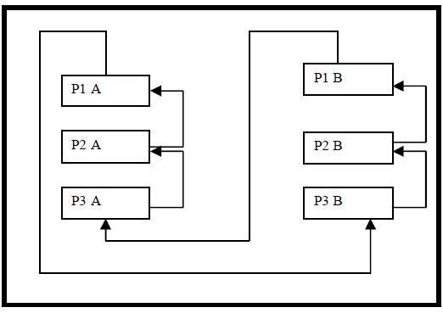
How I will attempt to answer the research question:
Some key findings from my research come up with a few different solutions to managing a Distributed Software Development team, One example is:
The paper Agile Communication Model for Distributed Software Development comes up with an interesting method to help tackle this issue.
In this model they propose intra and inter pair programming among distributed members.
One person from one team location can be paired with another person from another team
The pairs rotate every phase of the development
This lets one person share the details of what the other distributed team is working on

Slide 5
Agile Metrics
My questions is:
Are burndown charts suitable for use in Agile game development?

Slide 6
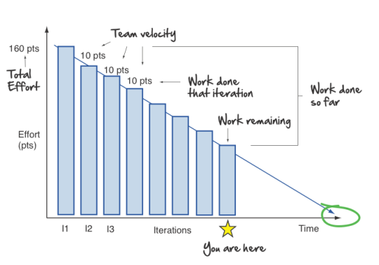
Agile Metrics
Most metrics are designed for enterprise software so I want to look at their suitability for games development
Also looking at designing or altering metrics to use alongside/in a burndown chart
“Measurement drives behaviour” – Hartmann & Dymond
Altering the metric may effect the software produced

Slide 7
Agile Metrics
Burndown charts appear to be commonly used in Agile
My chosen papers suggest they’re most helpful in enterprise software
In practise user stories may be reopened and more may be added in some software development processes making burndown charts less useful
Games development is likely to reopen and add many more user stories

Slide 8
Just how easy is it to integrate a new member into an agile team and how can this process be improved?
Communication
Documentation

Slide 9
Communication
Third party tool’s
Slack
Email
Scheduling system
International
“Android applications. Android phones are not widespread in India and Senegal. However, we decided to go with Android as all students were particularly excited to learn and use this development platform.” Christelle Scharff
Face to face
Scrum meeting
Extra time with more experienced programmers

Slide 10
Documentation
Ever-changing
Needs to be regularly updated
User stories
UML
Used primarily to model parts
Custom code
API’s
Programming style
comments

